Slide 1
Department of Mathematics and Natural Sciences
CHE 101: Introduction to Chemistry
Section A, Lecture 1
Content: Structure of atom, isotopes, isobar & isotones

Slide 2


Slide 3
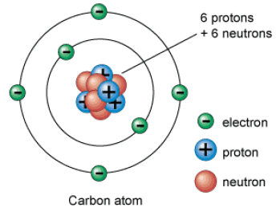
What is Chemistry
Matter
Matter is anything that has a mass and occupies space. Matter can be distinct substances or mixtures. The distinct substances are either elements or compounds.
If a substance is made up of only one kind of atoms, it is called element.
If, however it is made up of two or more kinds of atoms joined together in a definite proportion, it is called a compound.
Atom
All matter ̶ whether element, compound or mixture is composed of extremely small particles of matter that retains its identity during chemical reactions called atoms.
A table, a chair, even you are made up of atoms!

Slide 4
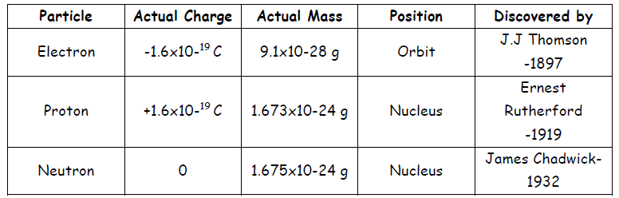
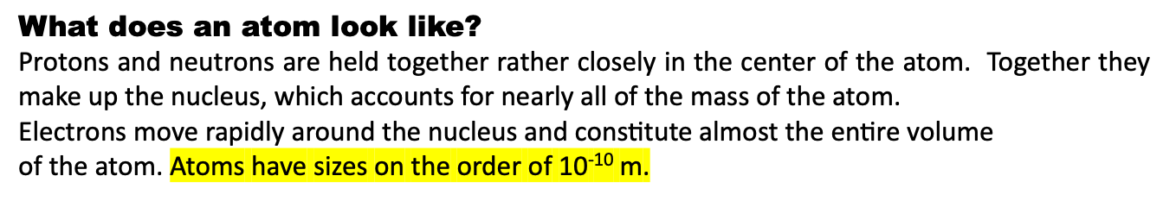
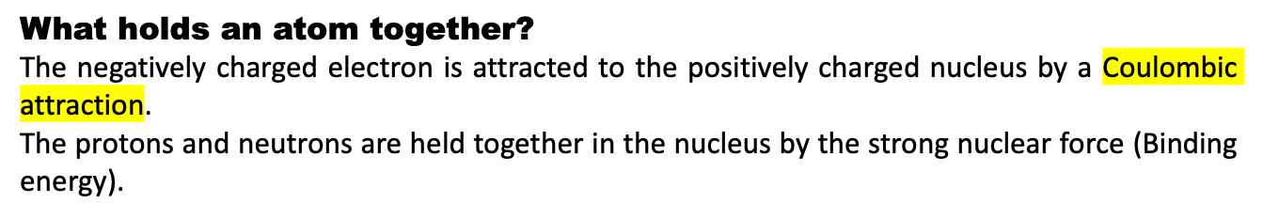
All atoms are made of three subatomic particles
Electrons, protons and neutrons

Slide 5
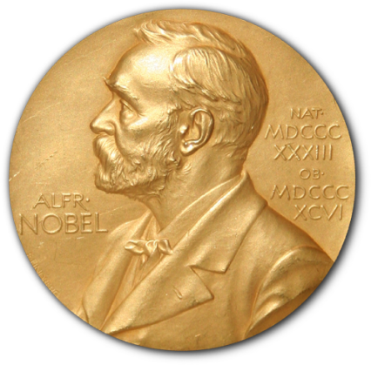
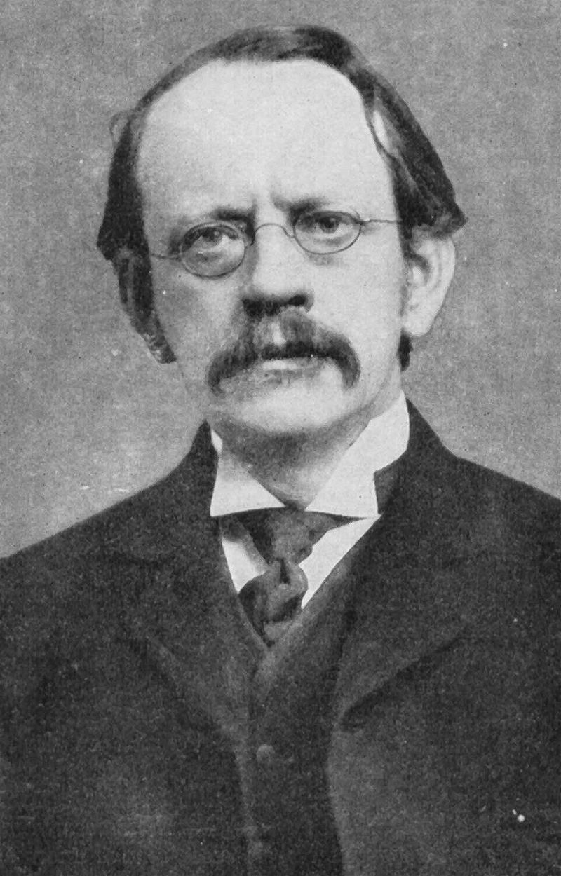
J J Thomson 1856-1940
Nobel Prize in Physics 1906
"in recognition of the great merits of his theoretical and experimental investigations on the conduction of electricity by gases."

Slide 6
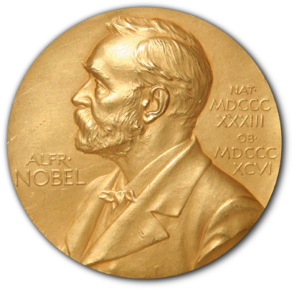
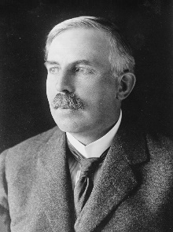
Earnest Rutherford 1871-1937
Nobel Prize in Chemistry 1908
"for his investigations into the disintegration of the elements, and the chemistry of radioactive substances."

Slide 7
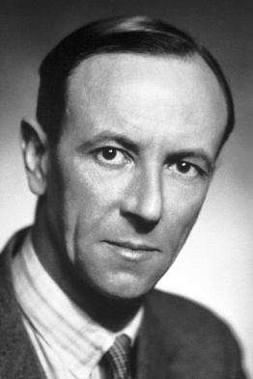
James Chadwik 1891-1974
Nobel Prize in Physics 1935
"for the discovery of the neutron."

Slide 8
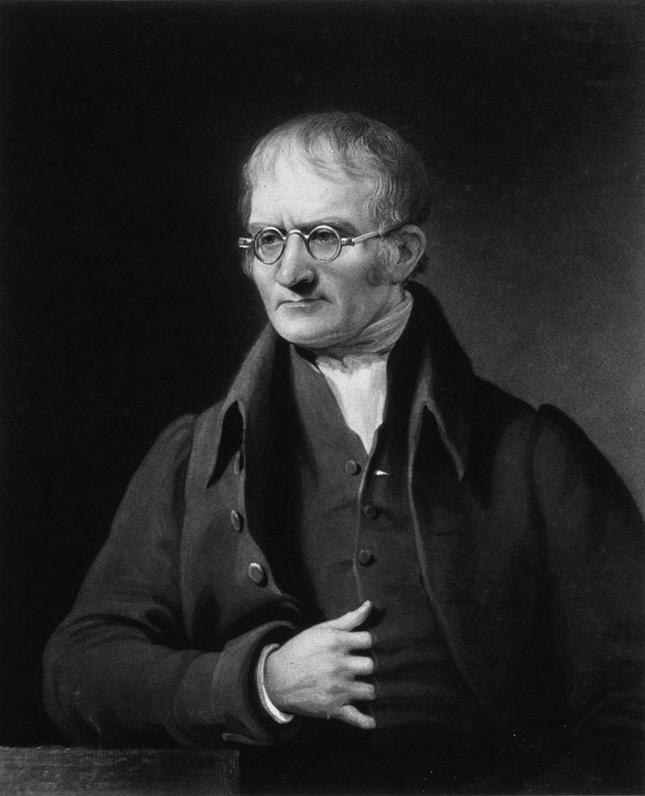
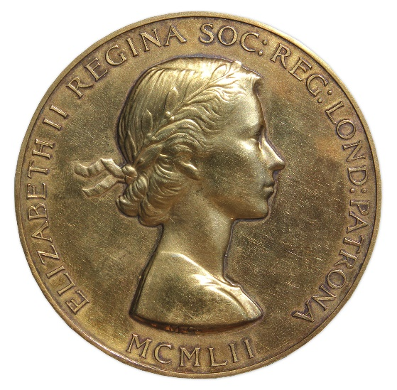
John Dalton1766-1844
Royal Medal in Physics 1826
"For his development of the Atomic Theory and his other important labours and discoveries in Physical Science."

Slide 9
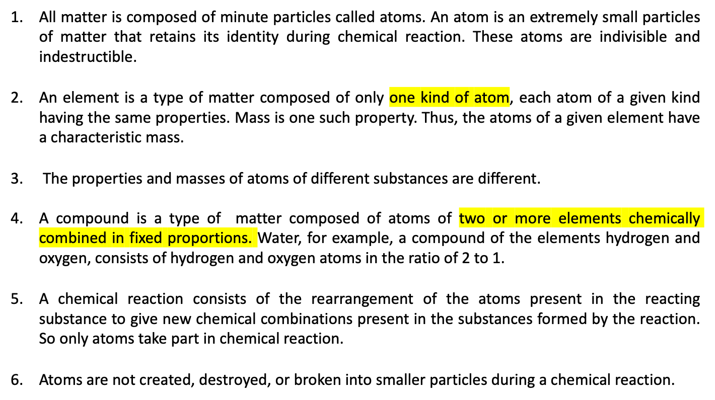
Postulates of Dalton’s Atomic Theory
British Chemist John Dalton (1766-1844) proposed a theory to explain the structure of matter in terms of different combinations of very small particles.

Slide 10
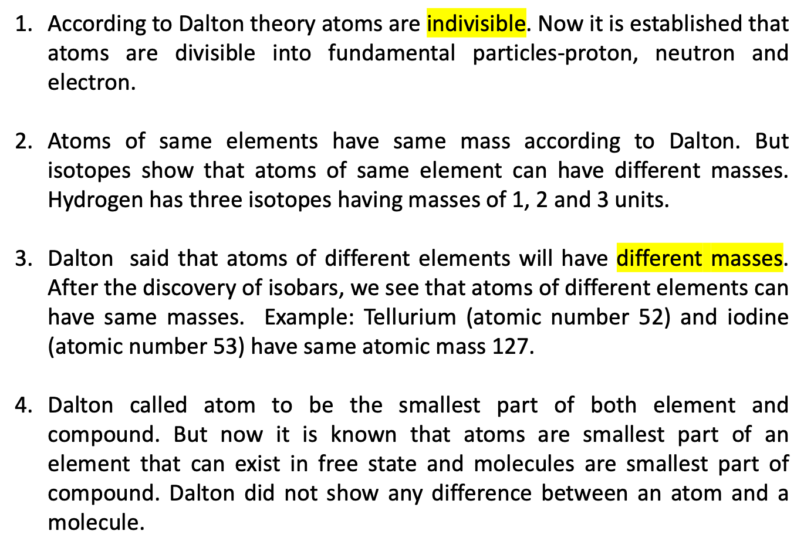
Limitations of Dalton’s Atomic Theory

Slide 11
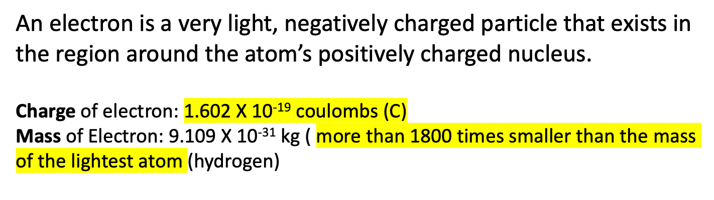
The structure of atom
Several experiments showed that an atom consists of two kinds of particles: a nucleus, the atom’s central core, which is positively charged and contains most of the atoms mass, and one or more electrons.
Electron

Slide 12
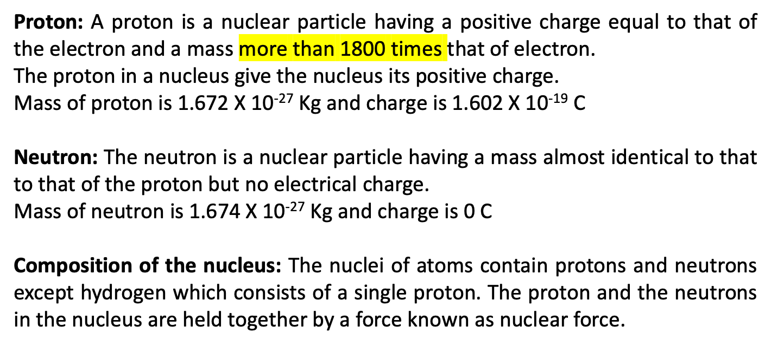

Slide 13
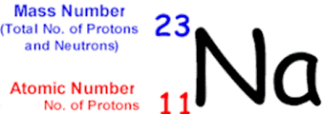
Some related terms
Atomic number: It is the number of protons in the nucleus of an atom.
The number of protons and electrons are equal in an atom as they are electrically neutral. So it can also be defined by the total number of electrons in the atom.
Atomic mass or mass number: It is the total number of protons and neutrons in a nucleus.
Nuclide: Nuclide is an atom characterized by definite atomic number and mass number.
The symbol for naturally occurring sodium nuclide is as follows:
Here, the atomic number is written as subscript and mass number is written as superscript. Atomic number of Na is 11, that is Na has 11 proton.
As the number of proton and electron in an atom is equal, so Na has 11 electron.
The number of neutron in Na is = 23 – 11 = 12

Slide 14
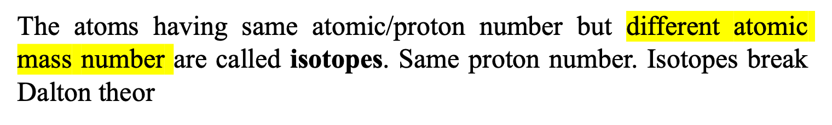
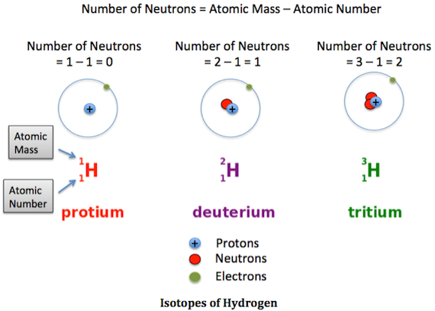
Isotopes

Slide 15
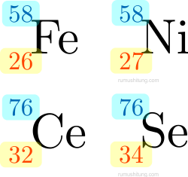
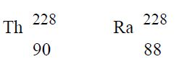
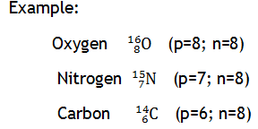
Isobars
Example:
Isotones
Atoms of different elements having different mass number and different atomic number but same neutron number are called Isotones.
Are isotones because of having same number of neutron (8)

